Slide 1


Slide 2
Topics
Introduction
Motivation
Potential Customers
Solution
Results
Application
Methodology

Slide 3
Introduction
Canada's agricultural terrain is as varied as its topography, offering a mosaic of chances and difficulties to individuals attempting to realize its potential fully.
Utilizing data-driven insights has become a potent tool for navigating the intricacies of contemporary agriculture.
To provide farmers, legislators, investors, and Agrotech entrepreneurs with useful insights, the team wants to use data analytics to find hidden patterns and trends in historical agricultural output data.
Notes:
The agricultural landscape of Canada is as diverse as its geography, presenting a tapestry of opportunities and challenges for those who seek to harness its potential.
Agriculture is one of the key industry which contributes the economy of Canada. To emprove

Slide 4

Motivation
Recognizing the importance of precision in agricultural decision-making due to dynamic market factors.
Recognizing the importance of providing information to investors, company owners, and aspiring farmers so they can make informed choices about what and where to plant.
Acknowledging the chance to fully realize Canada's agricultural potential and encourage sustainability and prosperity in rural regions across the nation by making efficient use of the data that is currently available.
Notes:
Understanding how crucial it is for farmers to make precise decisions in the ever-changing agricultural market, we all recognize the importance of giving investors, business owners, and newcomers the right information to help them decide what and where to grow.
It's about unlocking Canada's full farming potential and ensuring that rural communities thrive sustainably by using the data we already have effectively.

Slide 5

Potential Customers
Farmers
Agriculture-related business
Policymakers and Government Agencies
Agrotech Companies
Innovation Hubs
Academic and Research Communities
Consumers and Food Industry Stakeholders

Slide 6


Solution
The Canadian agriculture sector faces multifaceted challenges that hinder its potential for sustainable growth and innovation.
To overcome this, we aim to provide stakeholders with actionable insights and recommendations by integrating a variety of datasets covering market trends, and agricultural production, and by utilizing modern data analytics techniques.

Slide 7
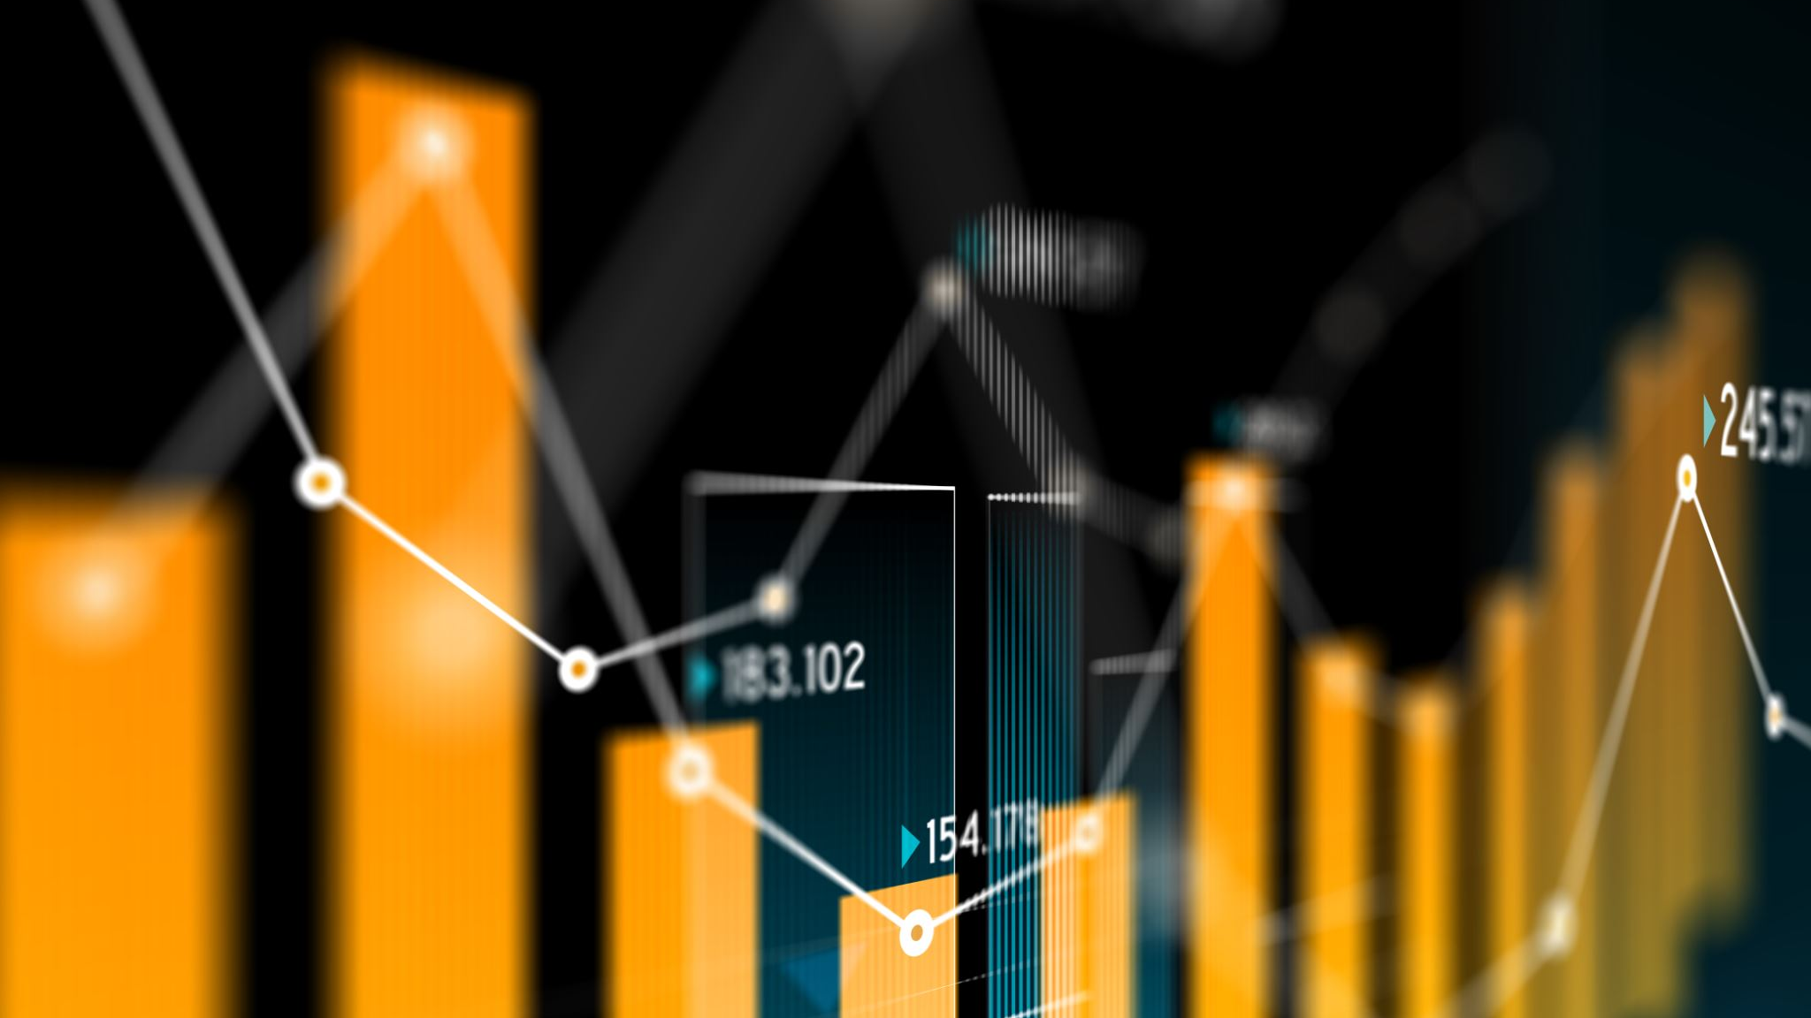
By leveraging historical agricultural production data from reputable sources such as the Government of Canada databases, we intend to analyze patterns, trends, and correlations that can inform strategic decision-making.
Key components of the solution include:
Data Collection and Preprocessing.
Exploratory Data Analysis (EDA).
Model Development and Evaluation
Prediction of estimated crop production
The overall goal of the suggested solution is to provide data-driven insights to all parties involved in the agricultural value chain, enabling them to make strategic investments, allocate resources optimally, and promote long-term, sustainable growth in the Canadian agriculture industry.

Slide 8
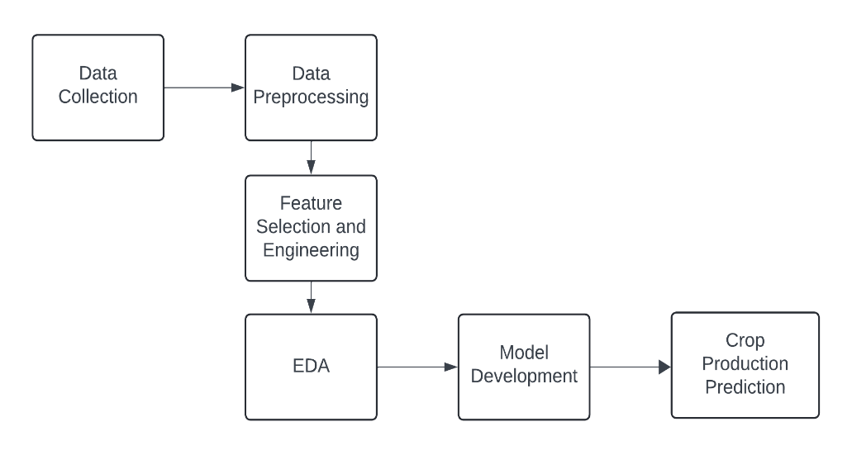
Methodology
Data Collection
Data Preprocessing
Feature Selection and Engineering
Exploratory Data Analysis (EDA)
Model Development
Crop Production Prediction

Slide 9
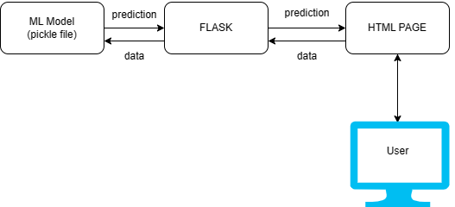
Methodology for Prediction Model

Slide 10
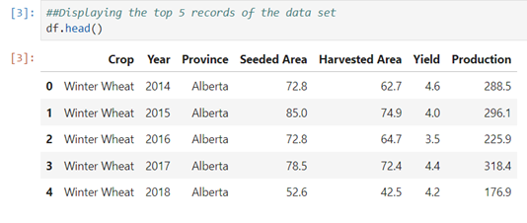
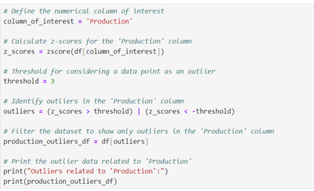
ML Model Building
Data Collection:
https://agriculture.canada.ca/en/market-information-system/rp/index-eng.cfm?action=pR&r=243&pdctc
Data Preprocessing:
1. Outlier Detection:
Here, a threshold of 3 standard deviations is used. Any data point with a z-score greater than 3 or less than -3 will be considered an outlier.

Slide 11
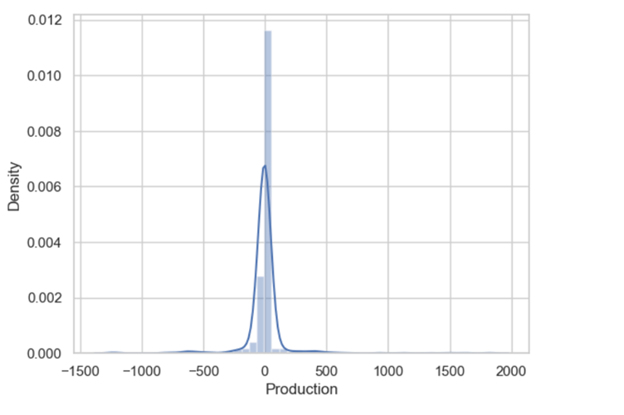
2. Dummy encoding: Converting categorical to numerical values (for province and crop)
Feature Engineering:
Independent Features: Crop, Province, Seeded Area, Yield
Dependent Feature: Production
Model Building:
Train data:80% Test data:20%
sns.distplot(ytest-predictions)
From the above distribution plot, it is evident that the difference between test data and predicted data are distributed more at the less error region for Random Forest Regression.
Algorithm | R2 Score
Linear Regression | 0.865896
Random Forest Regression | 0.898593

Slide 12
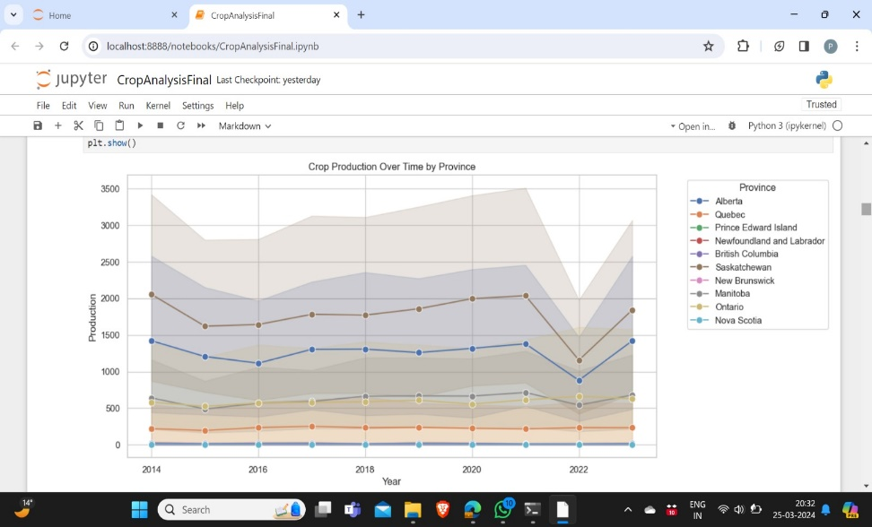
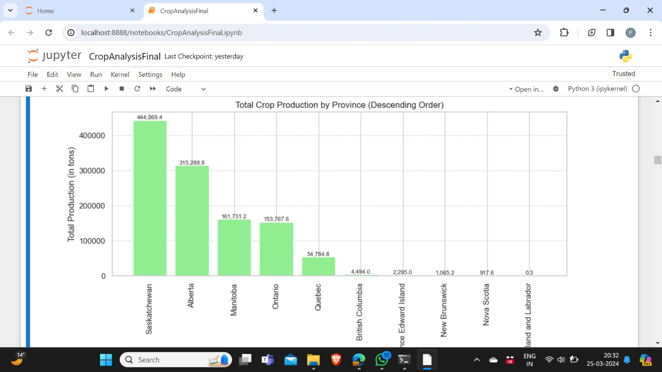
Results
we're creating a line plot where the x-axis represents the years, the y-axis represents the production of crops, and each line represents a province. This allows us to see how crop production has changed over time for each province.
We check individual crop production of top 5 provinces from the above bar chart over the decade

Slide 13
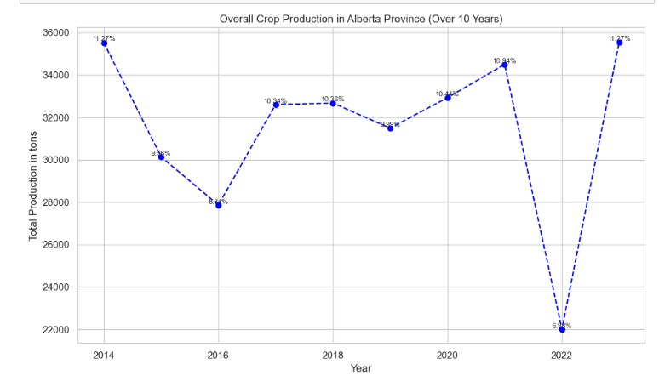
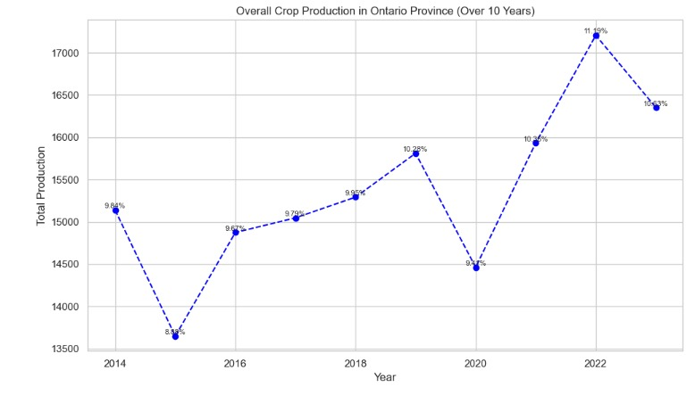
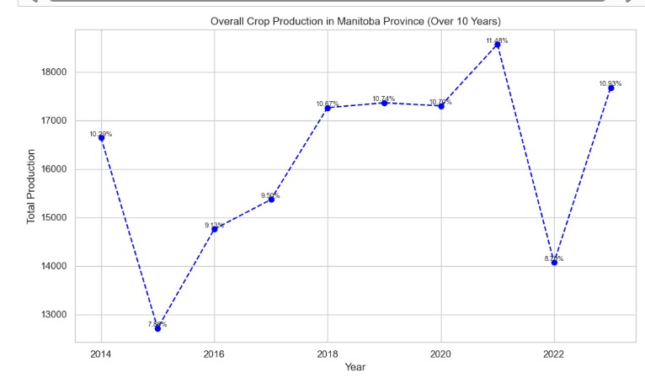
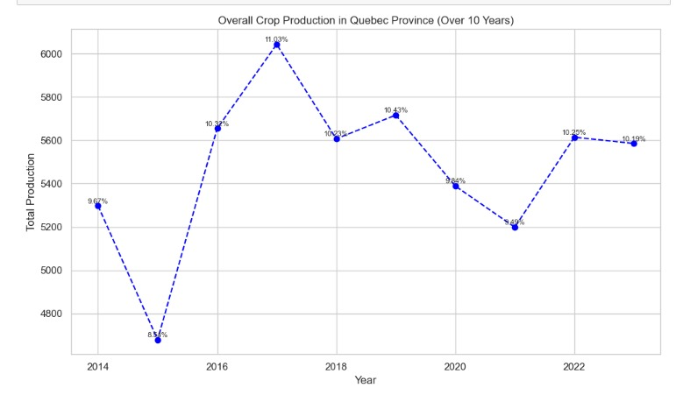

Slide 14
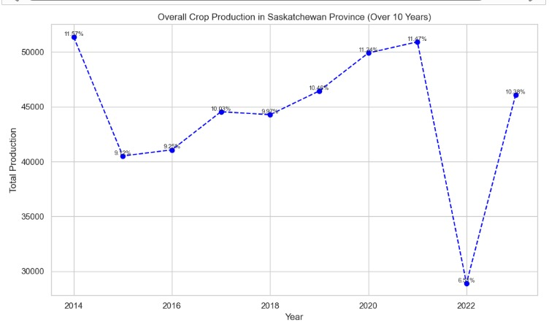
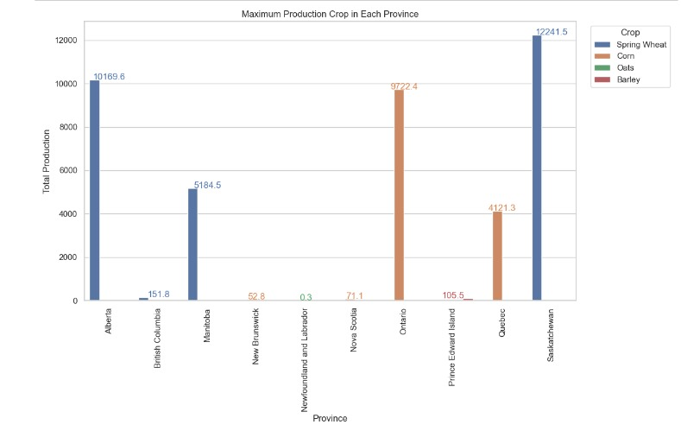
Overall crop production in Saskatchewan province (over 10 years)
Maximum Production Crop in Each Province

Slide 15
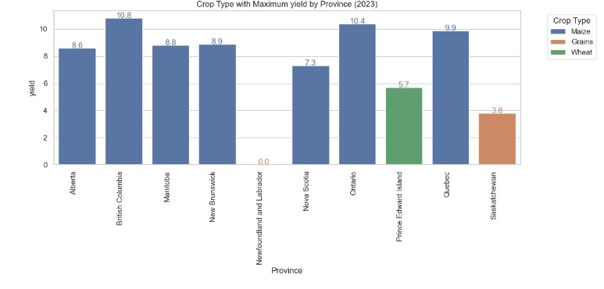
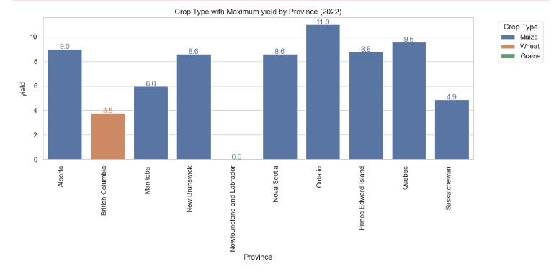
Crop type with Maximum yield by Province (2023)
Crop type with Maximum yield by Province (2022)

Slide 16
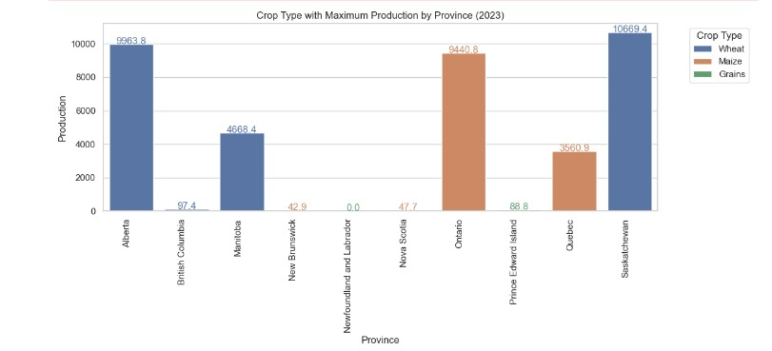
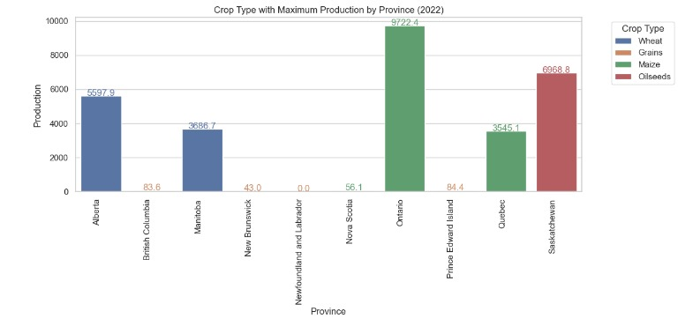
Crop type with Maximum production by Province (2023)
Crop type with Maximum production by Province (2022)

Slide 17
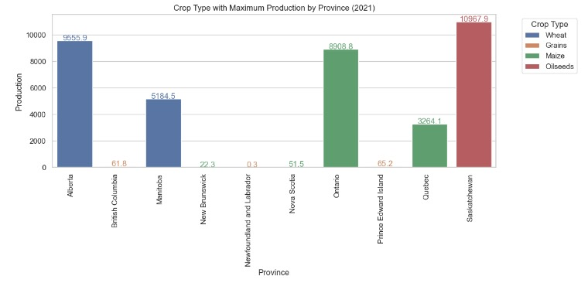
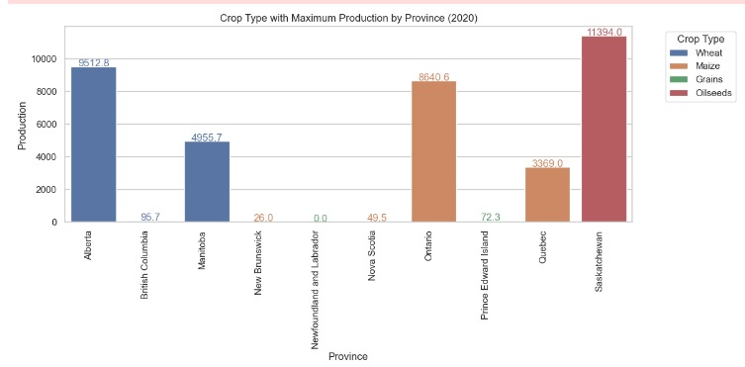
Crop type with Maximum production by Province (2021)
Crop type with Maximum production by Province (2020)

Slide 18
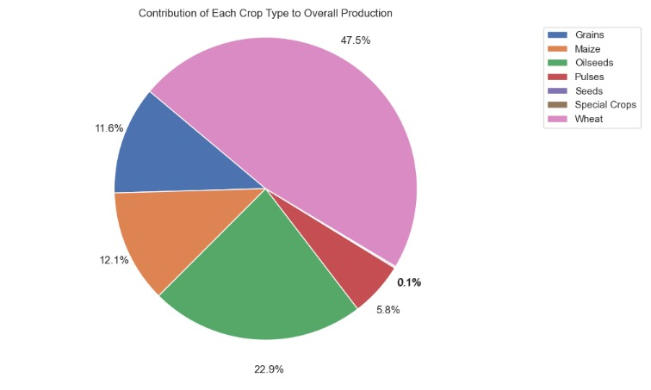
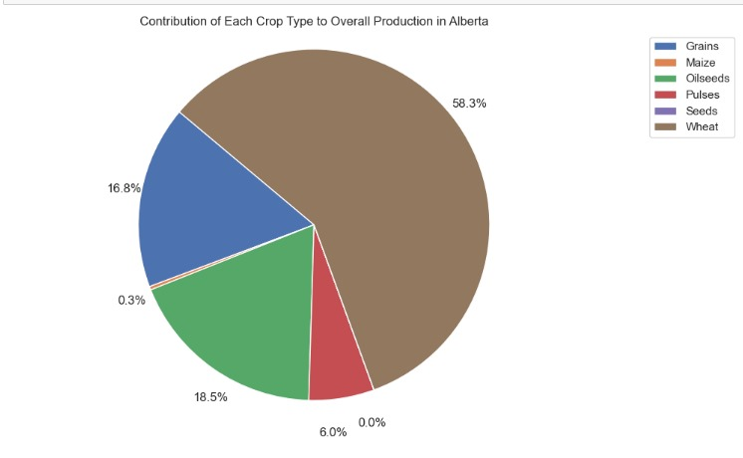
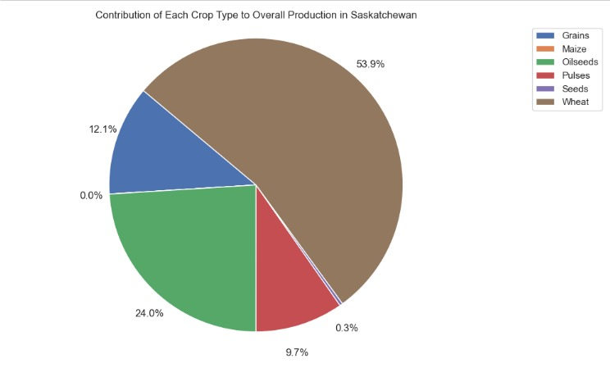
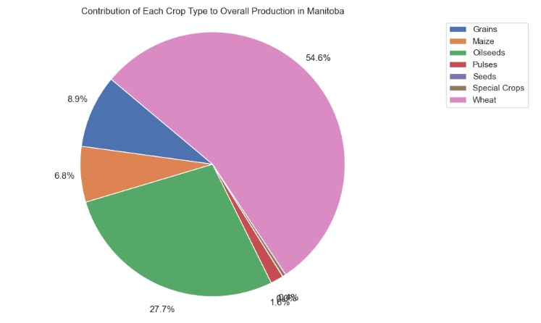

Slide 19

Insights found
We Identified top 5 provinces where production is more in the last decade.
Growth in crop production was identified in Alberta, Manitoba, Saskatchewan over the past two years.
We have identified crop in each province with maximum production.
There is not much difference in the yield of the crop type over the last two years in most of the provinces.
From 2020 to 2022 Oil seeds had the max production in Saskatchewan but as of 2023 Wheat was the most produced crop.
Wheat and Oil seeds are the major contributors to the agriculture sector of Canada.

Slide 20
Application of the Project
Agriculture Decision Making:
Based on past performance, climate adaptability, and market demand, prospective farmers and established agricultural enterprises can utilize the crop recommendation system to make well-informed selections about which crops to plant.
Investment Planning:
The predictive models can be used by financial institutions and investors who are interested in the agriculture industry to evaluate the possible profitability of agricultural operations in various Canadian provinces and areas.
Research and Development:
Researchers, academic institutions, and agricultural experts can all gain from having access to the extensive dataset and analytical tools created for this project.

Slide 21
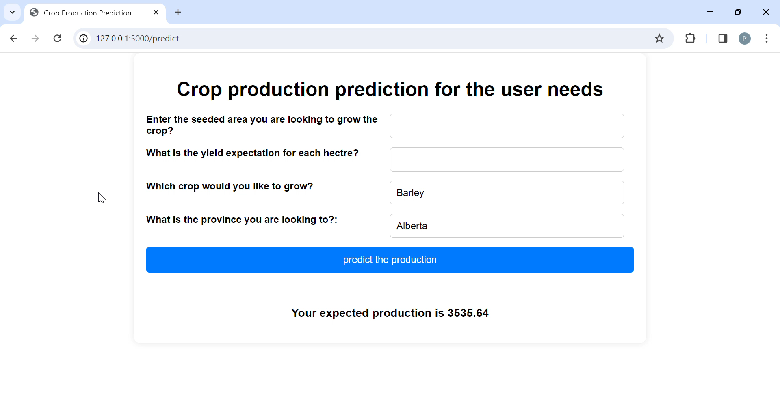
Demo

Slide 22
References
1. Liu, J., Elliott, J. A., Wilson, H. F., Macrae, M. L., Baulch, H. M., & Lobb, D. A. (2021). Phosphorus runoff from Canadian agricultural land: A dataset for 30 experimental fields. Data in Brief, 38, 107405.
2. Tseng, G., Zvonkov, I., Nakalembe, C. L., & Kerner, H. (2021, August). Crop harvest: A global dataset for crop-type classification. In Thirty-fifth Conference on Neural Information Processing Systems Datasets and Benchmarks Track (Round 2).
3. Xie, Q., Lai, K., Wang, J., Lopez-Sanchez, J. M., Shang, J., Liao, C., ... & Peng, X. (2021). Crop monitoring and classification using polarimetric RADARSAT-2 time-series data across growing season: A case study in southwestern Ontario, Canada. Remote Sensing, 13(7), 1394.
4. Chergui, N., & Kechadi, M. T. (2022). Data analytics for crop management: a big data view. Journal of Big Data, 9(1), 1-37.
5. Jacques, A. A. B., Diallo, A. B., & Lord, E. (2023). The Canadian Cropland Dataset: A New Land Cover Dataset for Multitemporal Deep Learning Classification in Agriculture. arXiv preprint arXiv:2306.00114.

Slide 23
